Slide 1




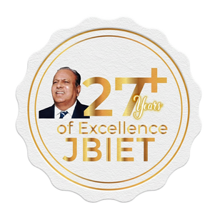






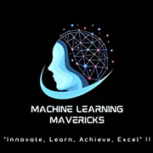

J.B.INSTITUTE OF ENGINEERING AND TECHNOLOGY
(UGC AUTONOMOUS)
Accredited by NAAC & NBA, Approved by AICTE & Permanently Affiliated to JNTUH
Organized by

Slide 2

TEAM DETAILS
1
Selected Track -
HERITAGE & CULTURE
2
Problem Statement Title -
Purv Vaibhav — Ancient Glory, Modern Technology
3
Vanara
Team Name -
4
Gandla Abhijeeth
Team Lead -
5
Dept. Name -
CSM

Slide 3
IDEA TITLE
Proposed Solution (Purv Vaibhav — Ancient Glory, Modern Technology App)
An intelligent cultural tourism application that leverages by using Google Gemini API Key to revive India’s monumental heritage.
It identifies monuments from photos, delivers AI-generated historical context, predicts crowd levels, and interacts conversationally with users in real time.
Innovation:
• AI-based monument recognition•
Multilingual storytelling and text-to-speech
• Crowd prediction and tour planning
• Preservation and precaution awareness messages
• Modern responsive interface with glassmorphism design

Slide 4
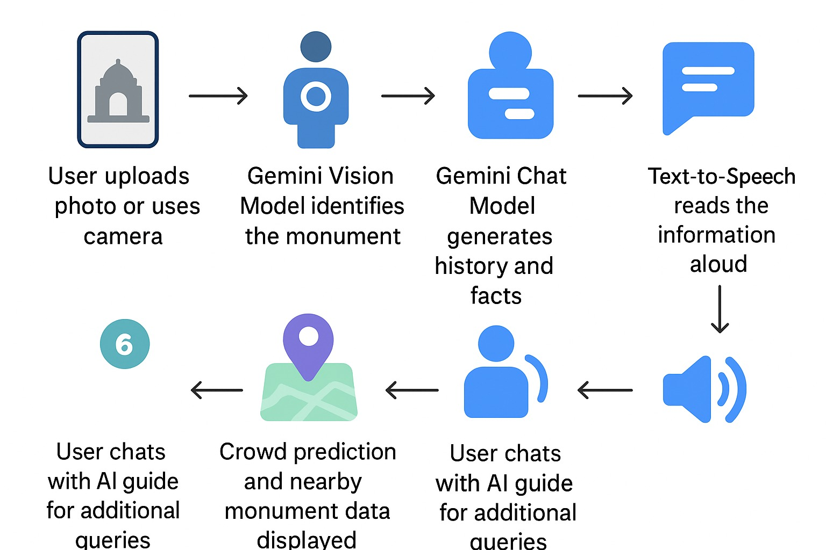
`
WORKFLOW DIAGRAM

Slide 5
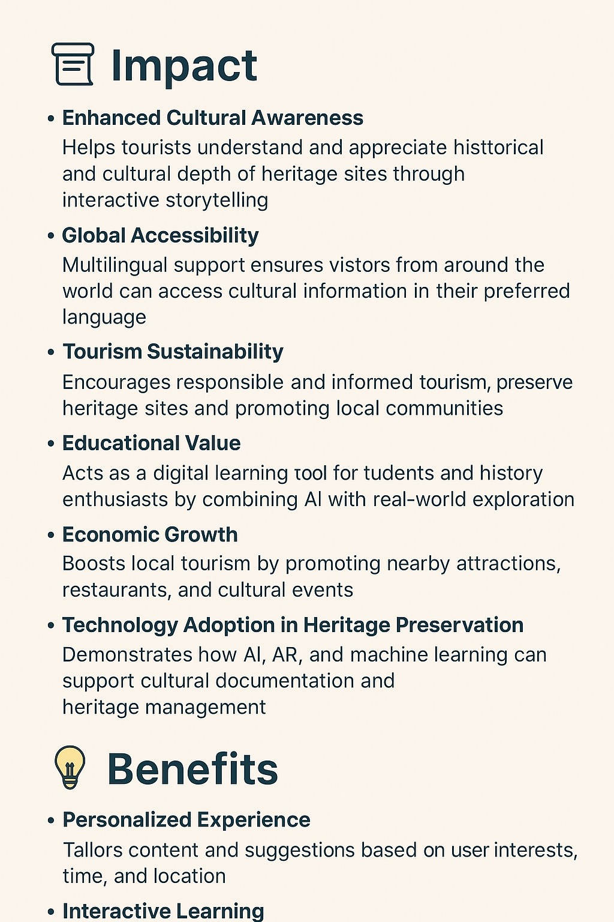
TECHNICAL APPROACH
Technologies:
• Frontend – React + TypeScript + Tailwind CSS
• Backend/AI – Google Gemini API Key (gemini-2.5-flash)
• Icons – Phosphor Icons
• Local Server – npx server
Gemini AI Modules:
• Vision Model – Monument Recognition
• JSON Mode – Structured Data & Crowd Prediction
• Chat Model – Conversational Tour Guide
Methodology:
Capture → Recognize → Generate → Narrate → Guide

Slide 6
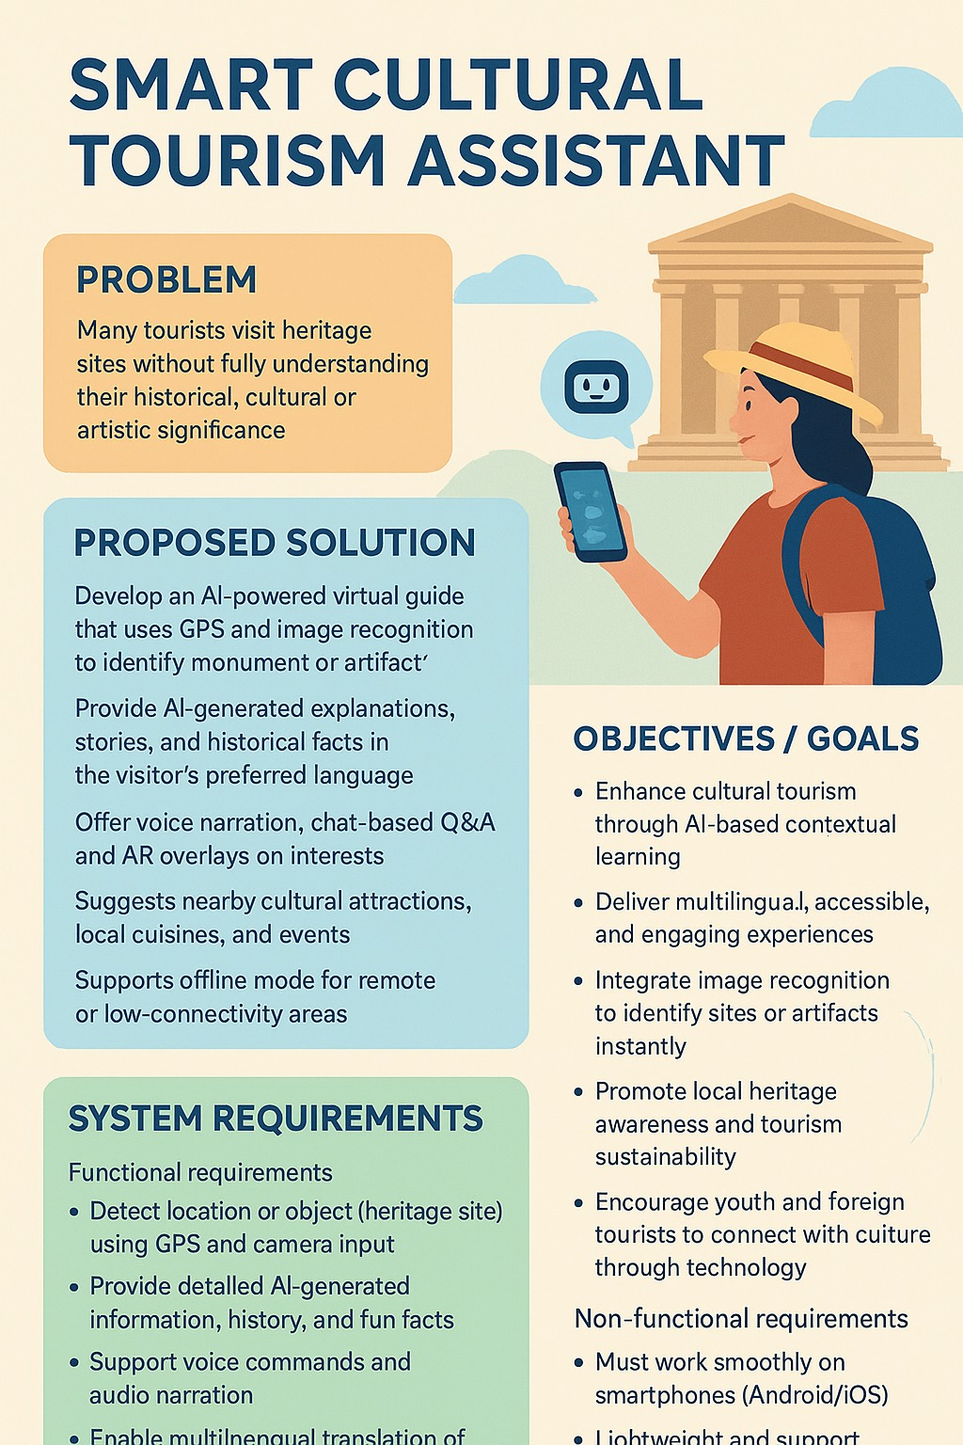
FEASIBILITY AND VIABILITY
Feasibility:
• Serverless architecture – lightweight and scalable
• Uses Google’s Gemini AI via API integration
• Requires only a browser and internet connection
Challenges:
• Dependence on API for online responses
• Limited free-tier API usage
Solutions:
• Cache popular monument data locally
• Integrate offline mode for basic facts
• Optimize image size for faster recognition

Slide 7
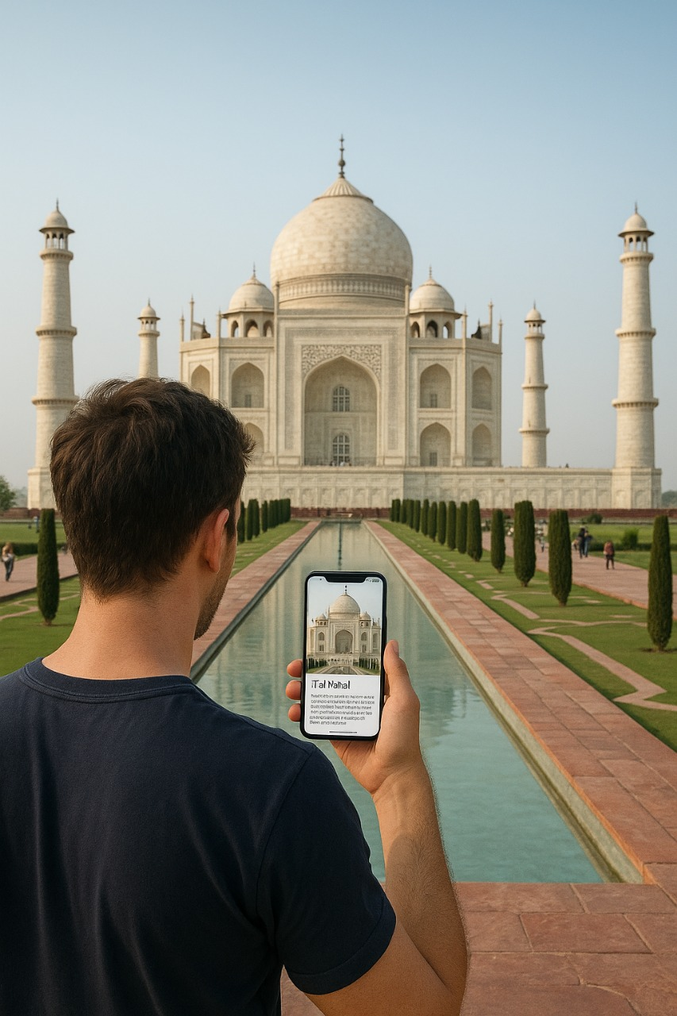
IMPACT AND BENEFITS
• Promotes digital heritage education and cultural awareness
• Improves tourism planning with AI predictions• Supports responsible tourism through preservation guidelines
• Engages youth with interactive, AI-driven learning
• Bridges technology and tradition in a modern way
TAGLINE:
Purv Vaibhav — Bridging India’s Ancient Glory with Modern AI.”

Slide 8
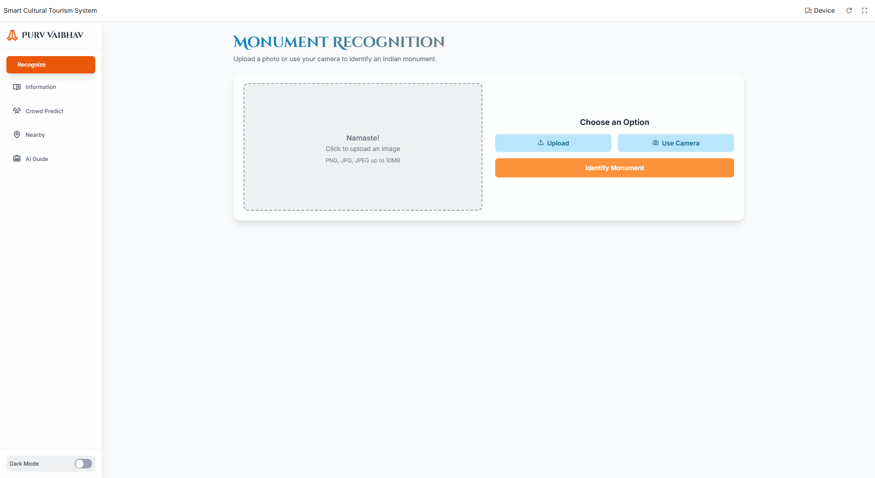
Application Interface Snapshots

Slide 9
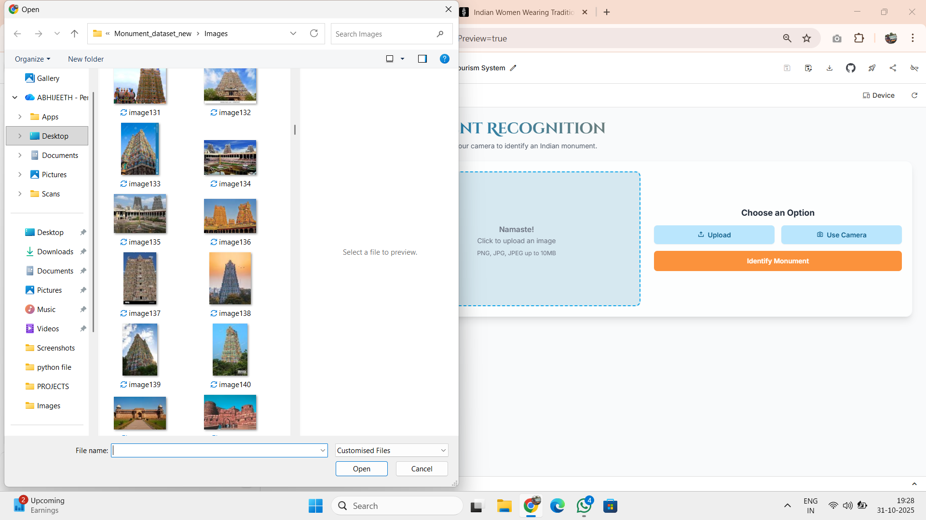
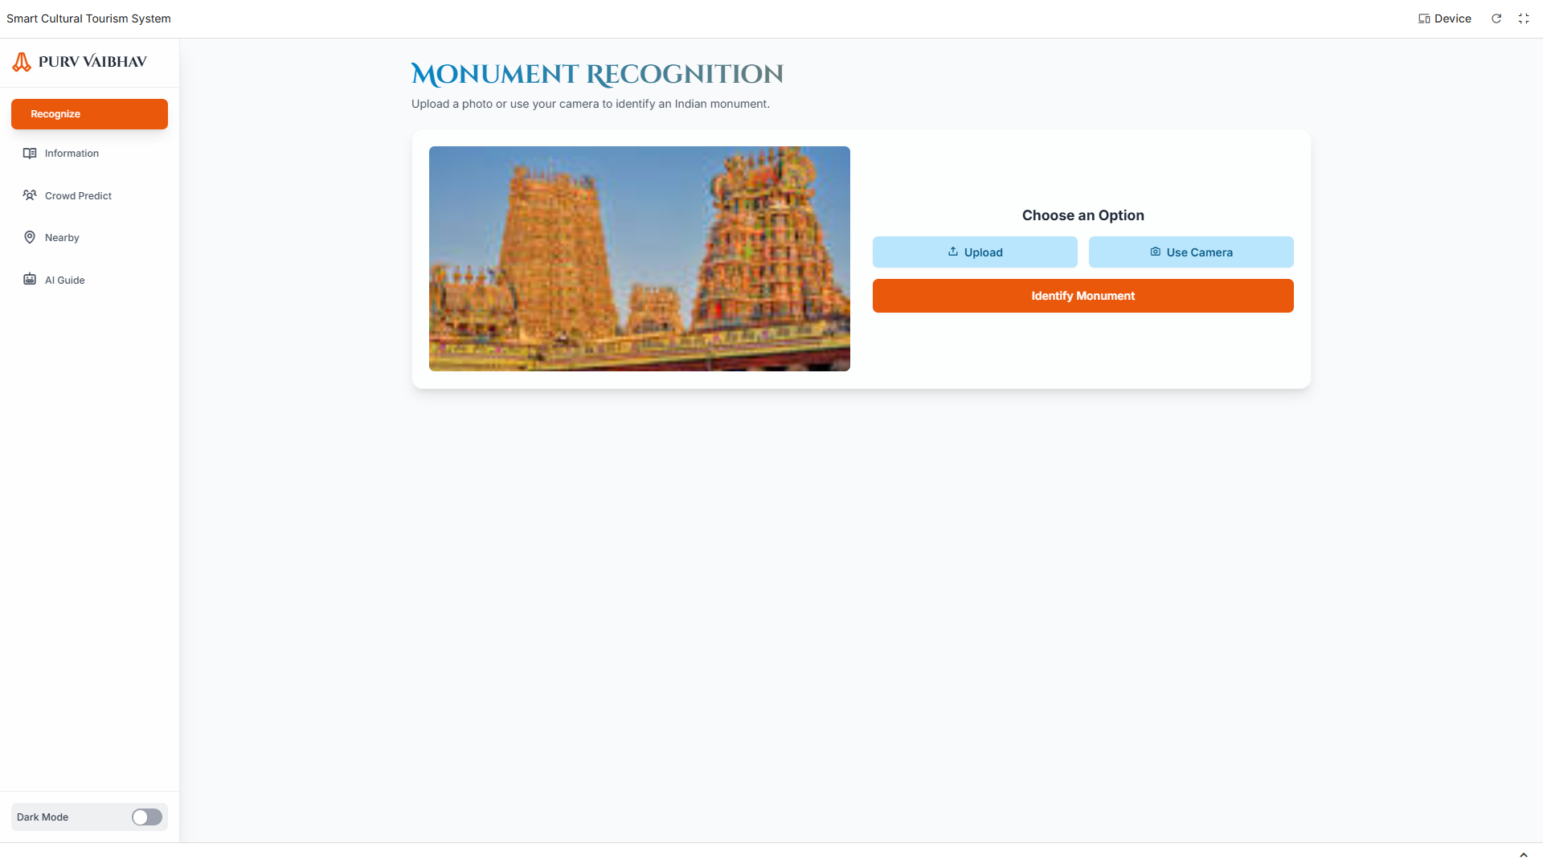

Slide 10
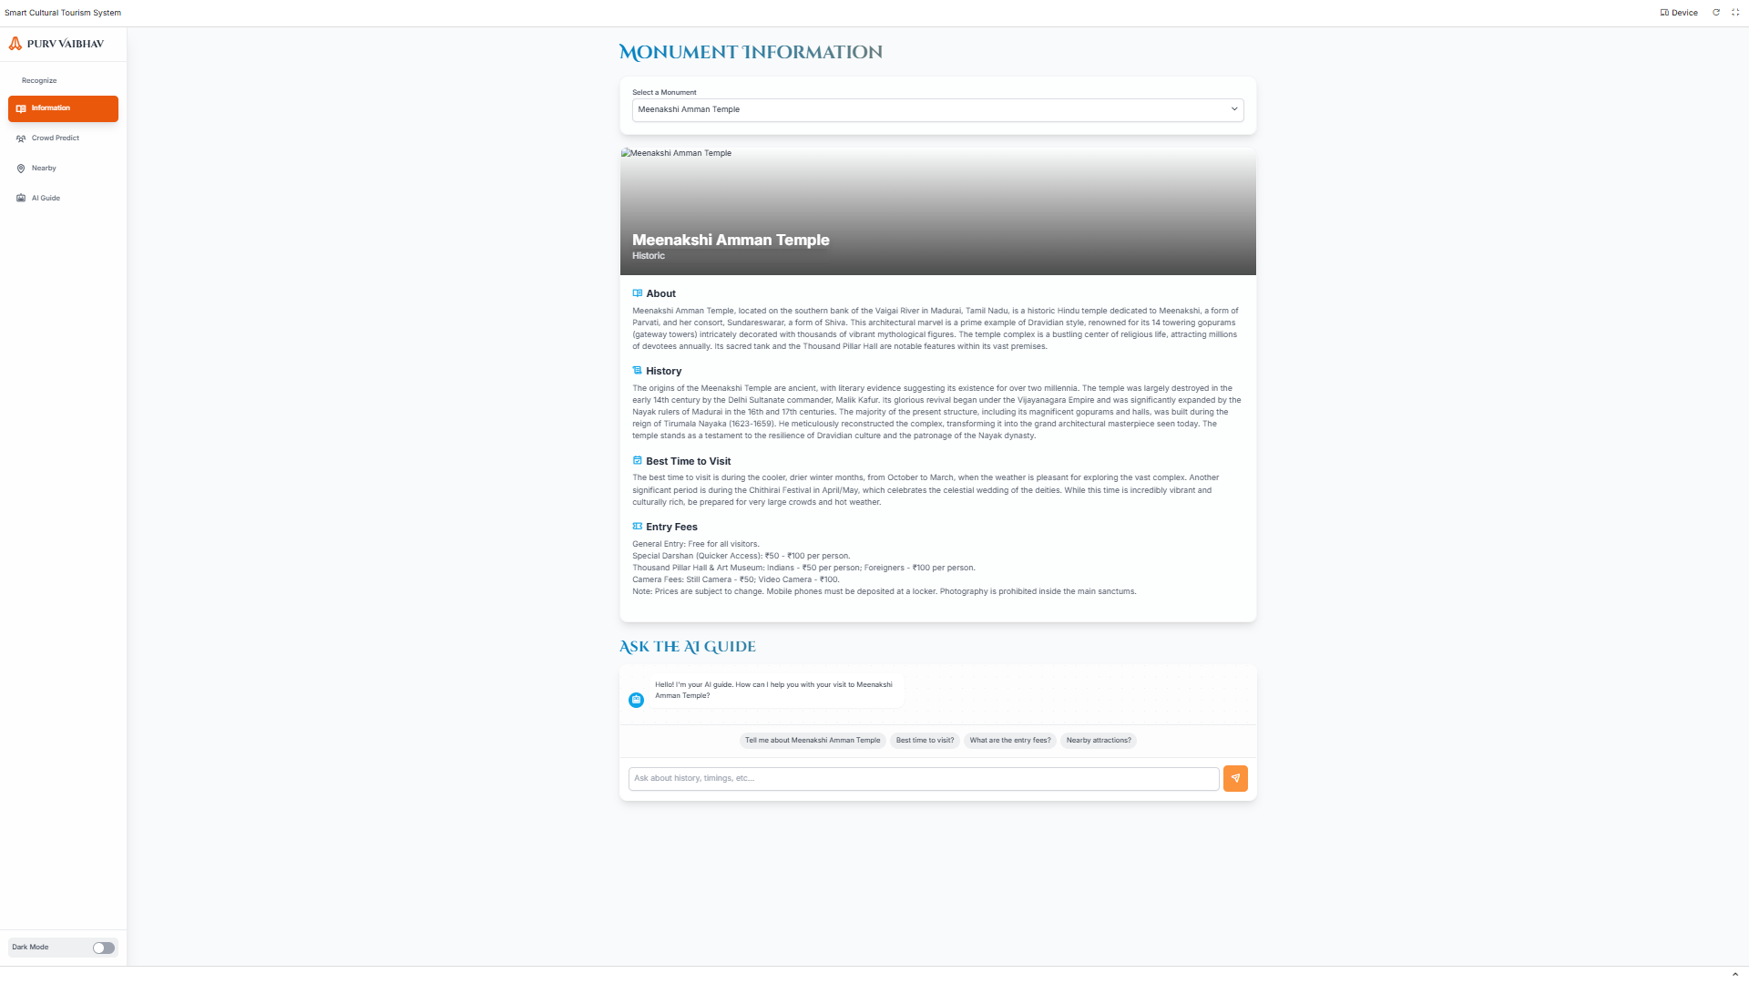
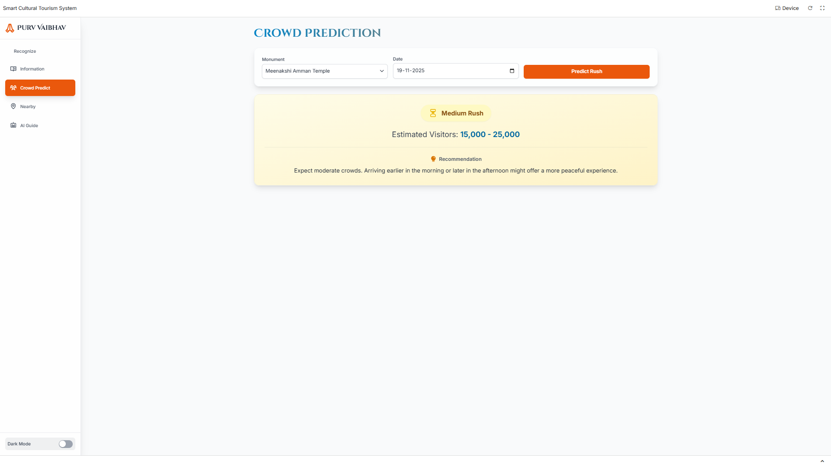

Slide 11
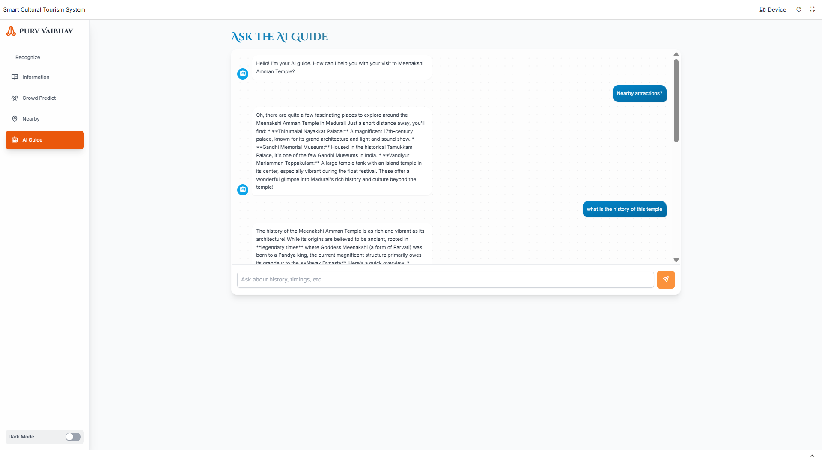
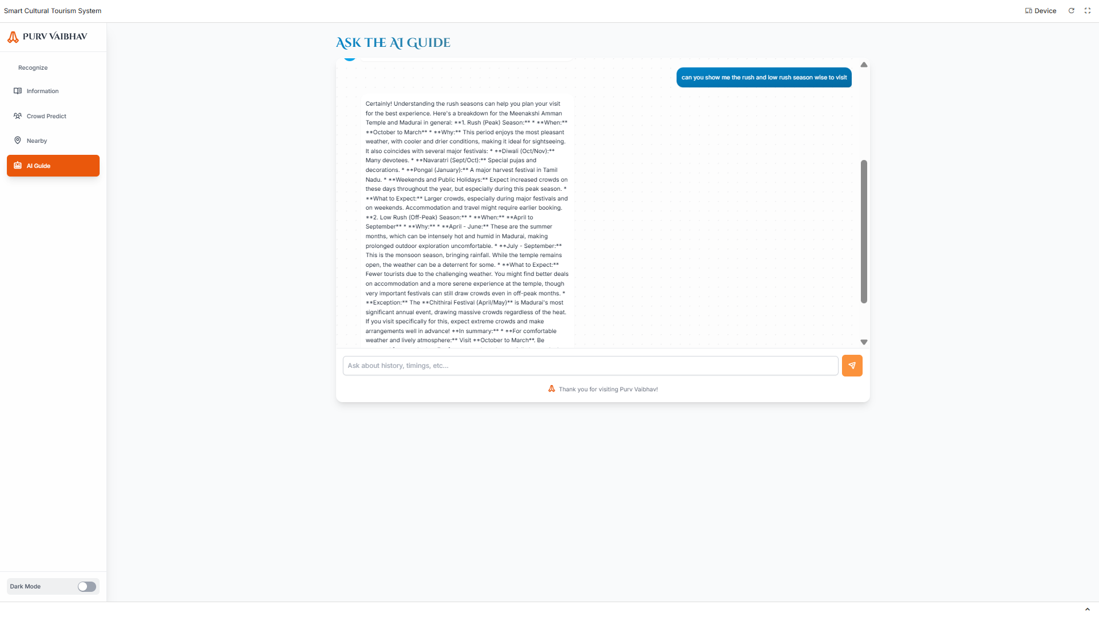

Slide 12
Team Member’s Information
Team Leader Name: (Gandla Abhijeeth)
Year: 3rd year Department: CSM Roll Number: 23671A6620
Team Member 1 Name: (Thammishetti Rohith)
Year: 3rd year Department: CSM Roll Number: 23671A6655
Team Member 2 Name: (Gajula Anish)
Year: 3rd year Department: CSM Roll Number: 23671A6618
Team Member 3 Name: (Karrolla Nishank Nanda Kishore)
Year: 3rd year Department: CSM Roll Number: 23671A6628

